Slide 1


Slide 2
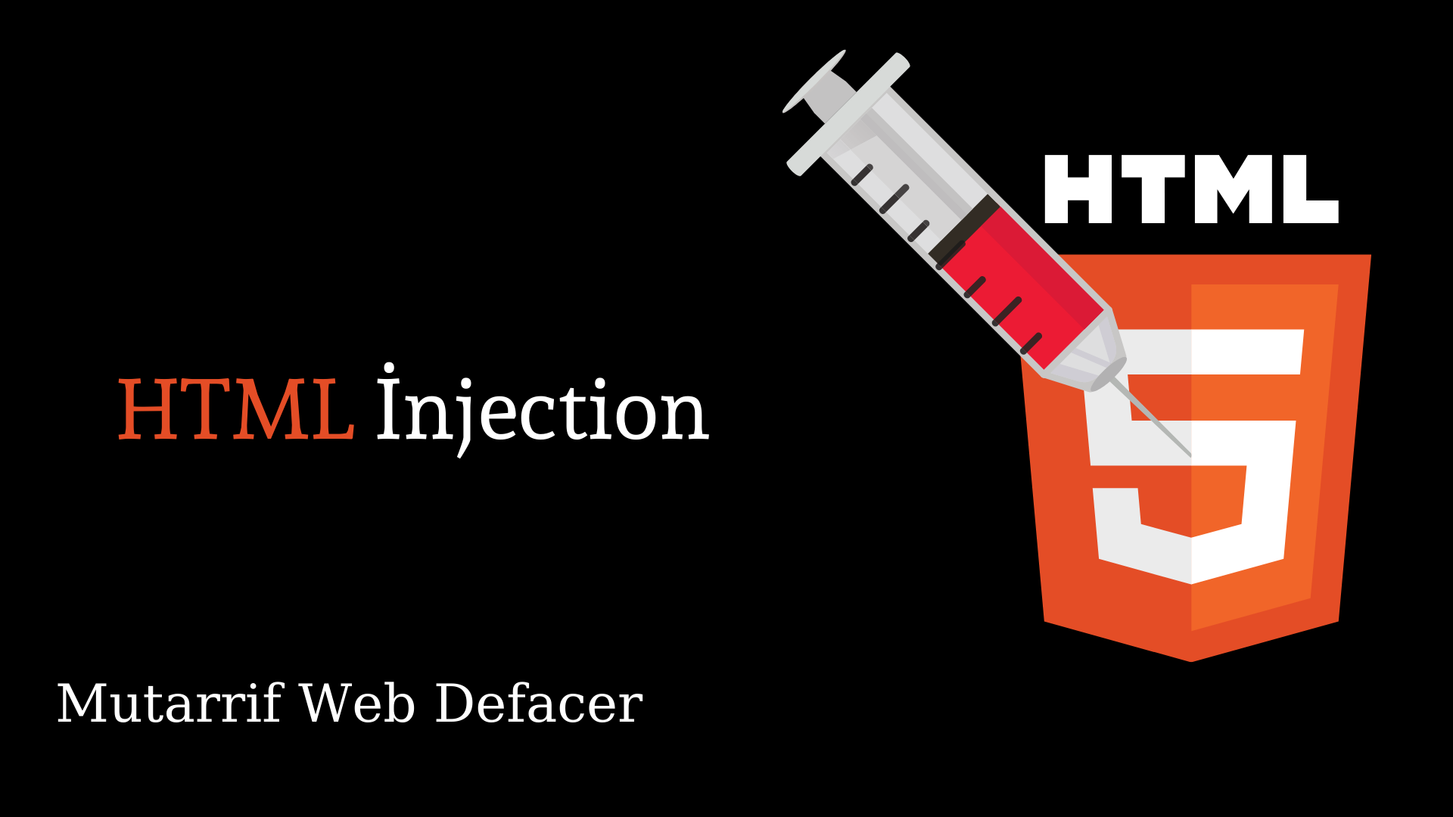

1. Basics of html
2. What is html injection
3. Impact of html injection
4. Types of html injection
5. Live Demo

Slide 3
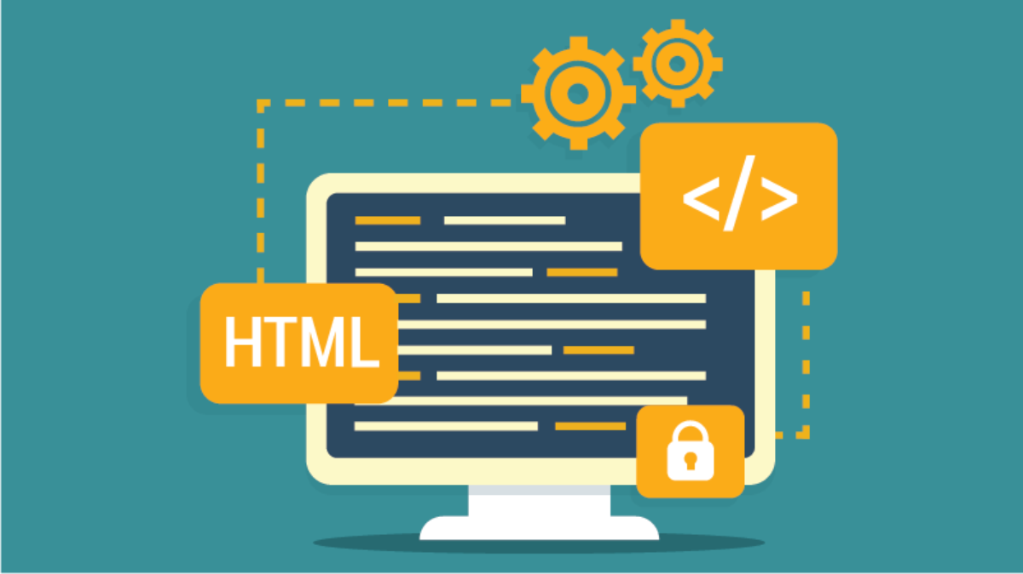
Basics of html
HTML is the abbreviation for HyperText Markup Language.It's a markup language that's used to create web pages. HTML is a markup language that combines hypertext with markup. The term "hypertext" refers to the link between web pages.
HTML is a markup language used by the browser to manipulate text, images, and other content, in order to display it in the required format. So you'll use assisted technologies such as CSS and JavaScript to make your HTML beautiful and add interactivity, respectively.
HTML document is made of many HTML tags and each HTML tag contains different content.

Slide 4
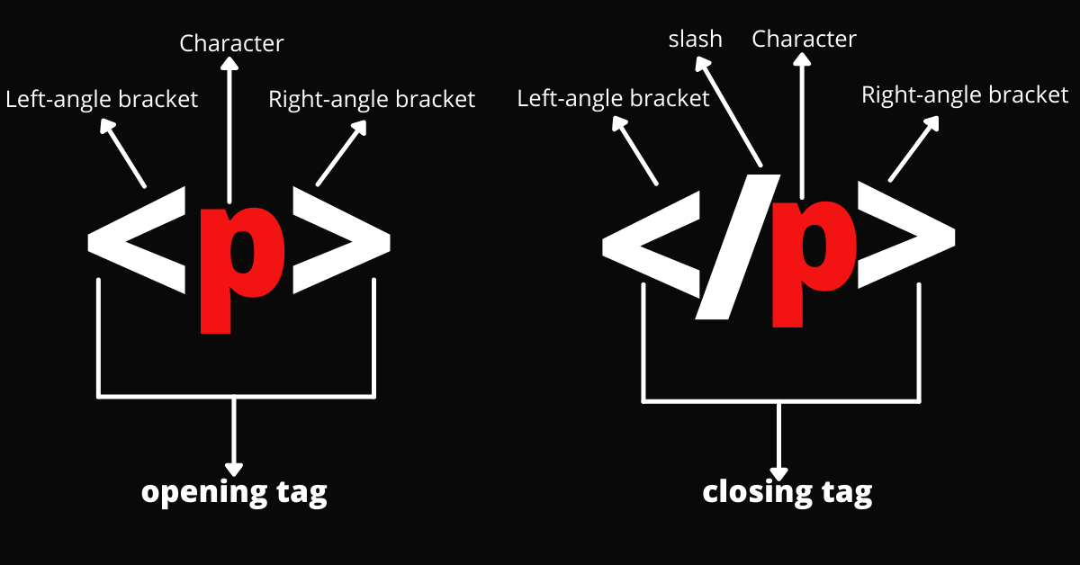
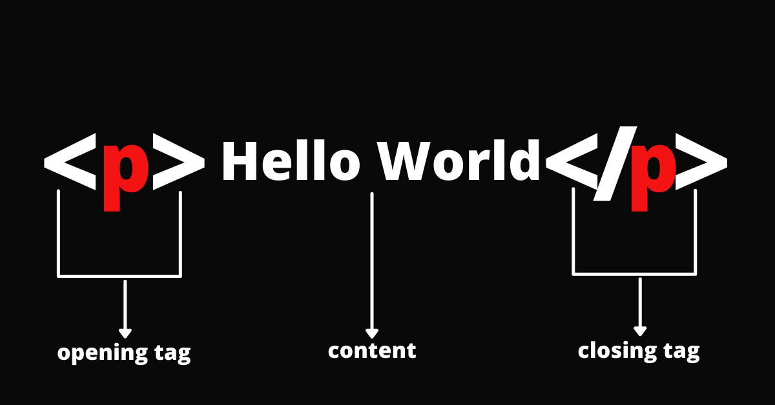
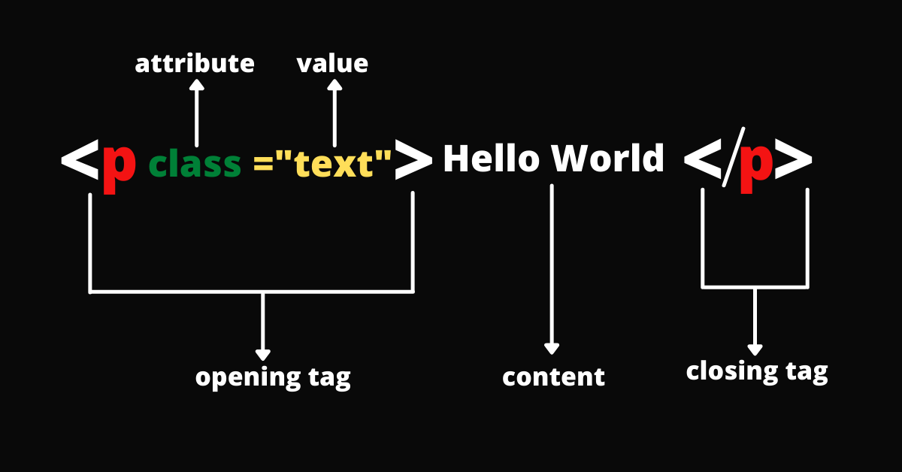
Let's see a simple example of HTML.
<!DOCTYPE>
<html>
<head>
<title>Web page title</title>
</head>
<body>
<h1>Write Your First Heading</h1>
<p>Write Your First Paragraph.</p>
</body>
</html>

Slide 5
What is html injection
HTML injection is a type of injection vulnerability that occurs when a user is able to control an input point and is able to inject arbitrary HTML code into a vulnerable web page.
This vulnerability occurs when user input is not correctly sanitized and the output is not encoded. An injection allows the attacker to send a malicious HTML page to a victim
This attack is typically used in conjunction with some form of social engineering, as the attack is exploiting a code-based vulnerability and a user's trust.

Slide 6
Impact of html injection
It can allow an attacker to modify the page.
To steal another person’s identity.
The attacker discovers injection vulnerability and decides to use an HTML injection attack.
Attacker crafts malicious links, including his injected HTML content, and sends it to a user via email.
The user visits the page due to the page being located within a trusted domain.
The attacker’s injected HTML is rendered and presented to the user asking for a username and password.
The user enters a username and password, which are both sent to the attacker’s server.

Slide 7
Example for html injection
Normal Search Template
<html>
<h1>Here are the results that match your query: </h1>
<h2>{user-query}</h2>
<ol>
<li>Result A
<li>Result B
</ol>
</html>

Slide 8
Attacker Input Query
<h2>special offer <a href=www.attacker.site>malicious link</a></h2>
Attacker Input Query Redirect Malicious Site
<html>
<h1>Here are the results that match your query: </h1>
</h2>special offer <a href=www.attacker.site>malicious link</a><h2>
<ol>
<li>Result A
<li>Result B
</ol>
</html>

Slide 9
Types of html injection
Stored HTML Injection
Reflected HTML Injection
Stored HTML Injection
Stored injection attack occurs when malicious HTML code is saved in the web server and is being executed every time when the user calls an appropriate functionality.
The most common example of Stored HTML is the “comment option” in the blogs, which allow any user to enter his feedback as in the form of comments for the administrator or other users.

Slide 10
Reflected HTML Injection:
The reflected HTML also known as “Non-Persistence”
It is termed “non-persistent” In the reflected injection attack case, malicious HTML code is not being permanently stored on the web server.
Reflected Injection occurs when the website immediately responds to the malicious input. thus the attacker needs to send the malicious link through phishing to trap the user.
Reflected HTML vulnerability can be easily found in website’s search engines
Reflect HTML is basically of three types:
Reflected HTML GET
Reflected HTML POST
Reflected HTML Current URL

Slide 11
THANK YOU

